Slide 1
Lecture 2
Single s/c boundary studies

Slide 2
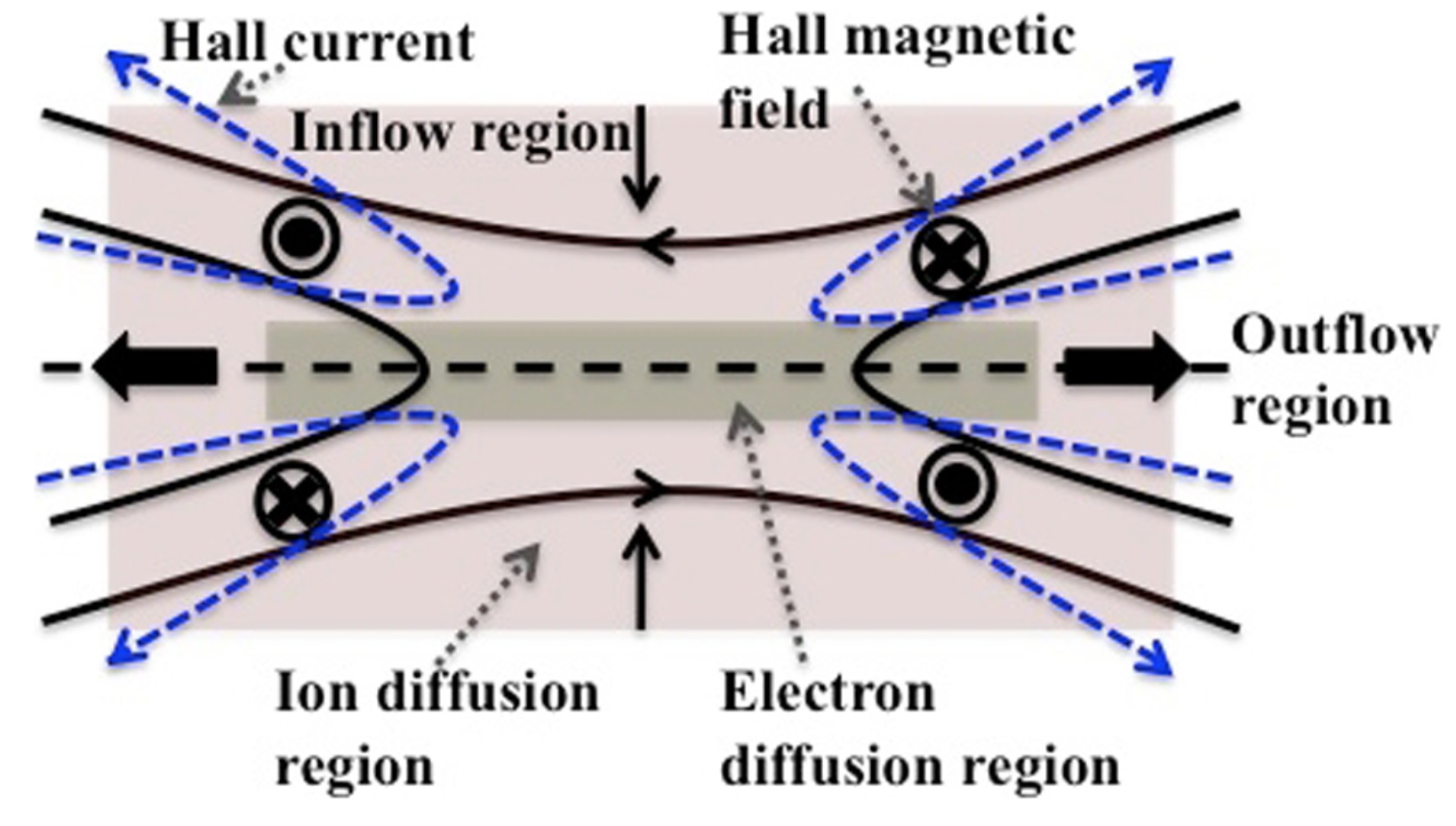
Reconnection diffusion region
[Borg et al, 2012, Ann Geo]

Slide 3
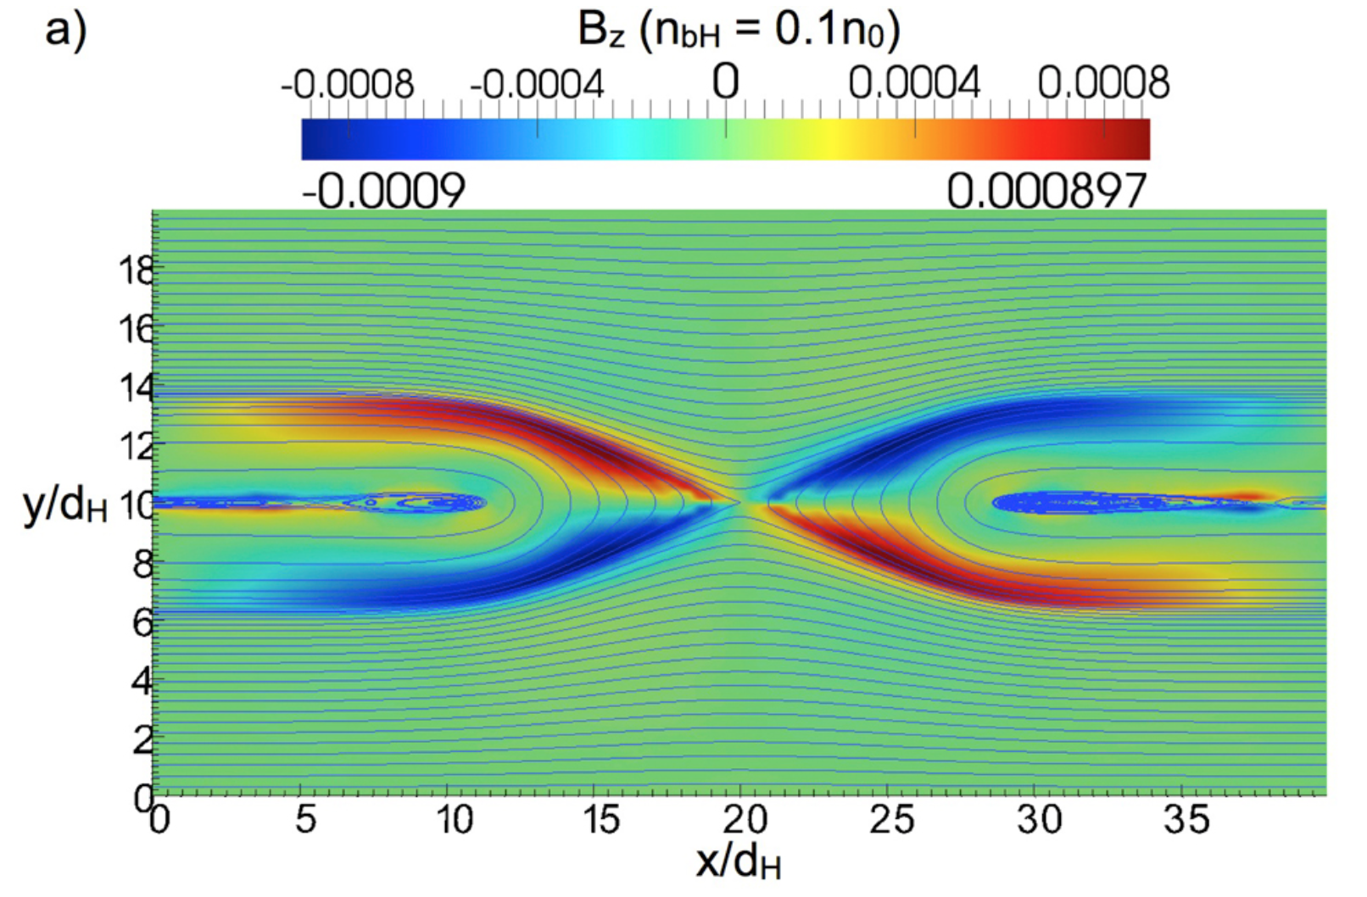
Reconnection diffusion region (Markidis et al., 2011, JGR)

Slide 4
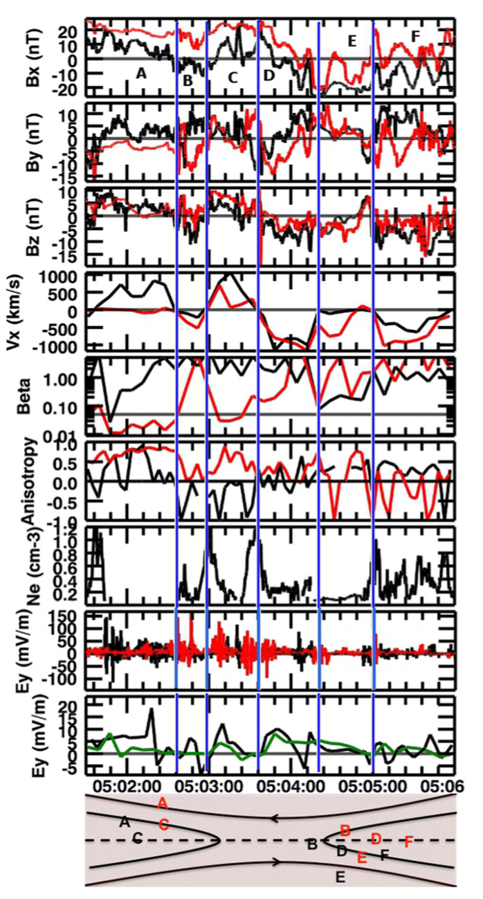
B reconnecting
B Hall field
B normal to current sheet
Reconnection jets
E waves
E reconnection
Ion diffusion region, tail reconnection (Borg et al., 2012, AnGeo)

Slide 5
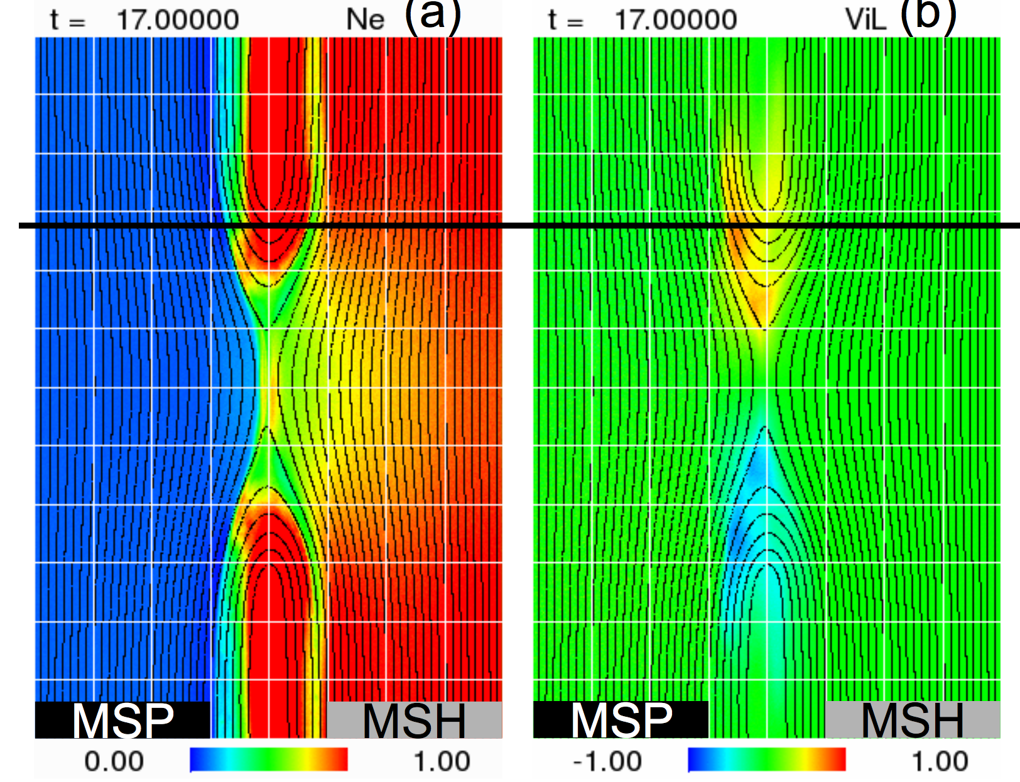
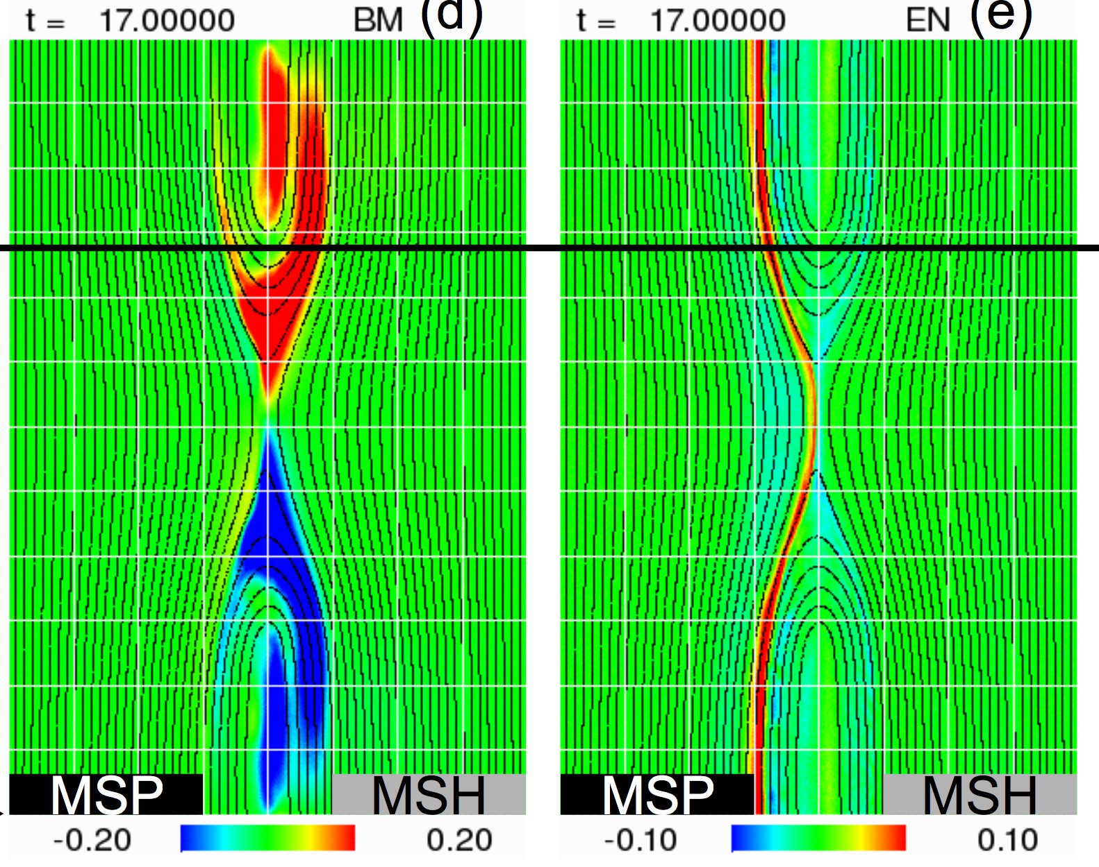
Asymmetric reconnection (Tanaka et al., 2008, AnGeo)
Density asymmetry
Reconnection jet
observed on magneto- spheric side
Hall B field Does not show quadrupolar structure.
E normal Strong on magnetosph
separatrix

Slide 6
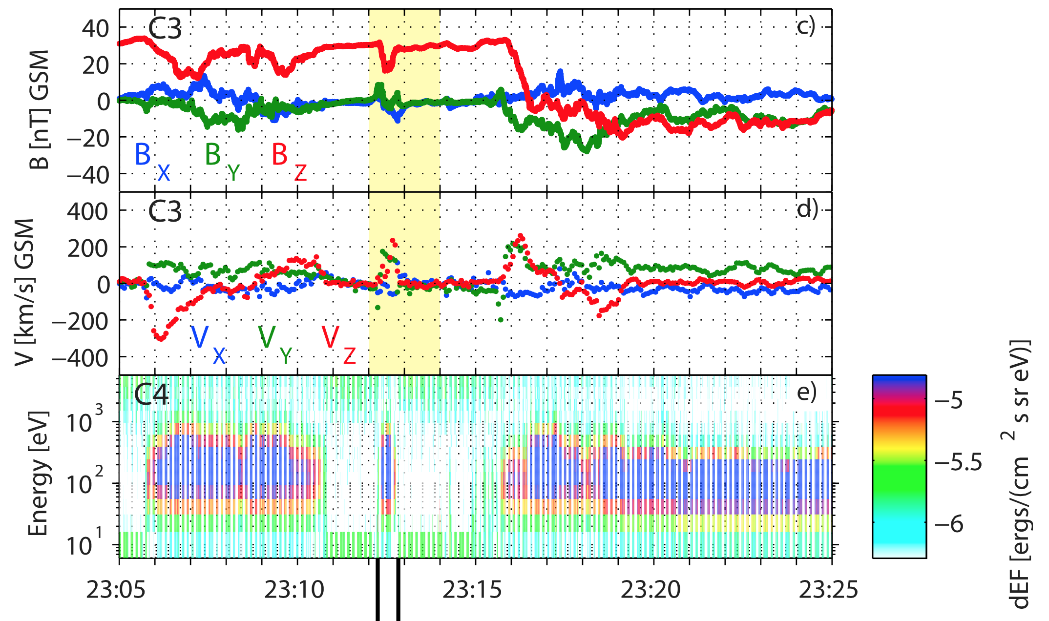
Ion diffusion region, magnetopause reconnection (André et al, 2010, GRL)
2008-03-03 UTC

Slide 7
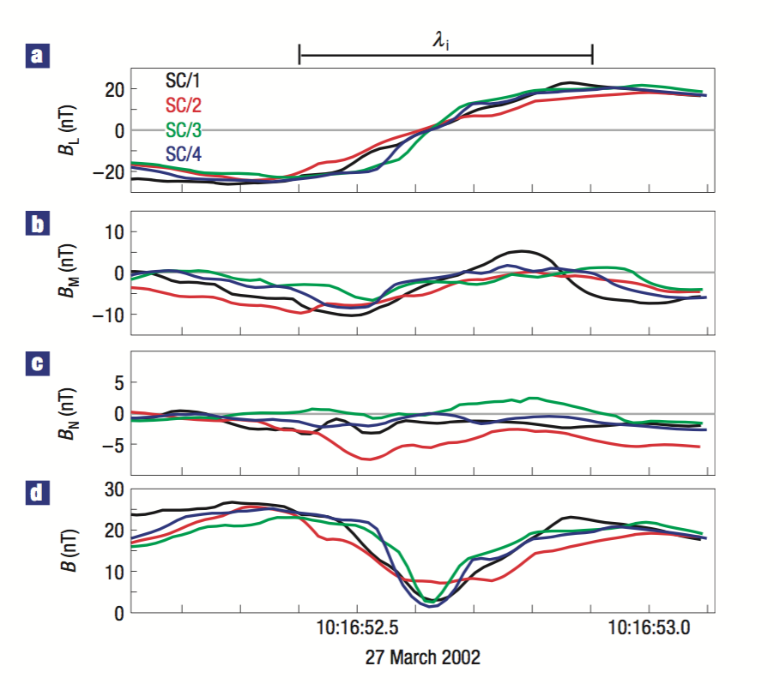
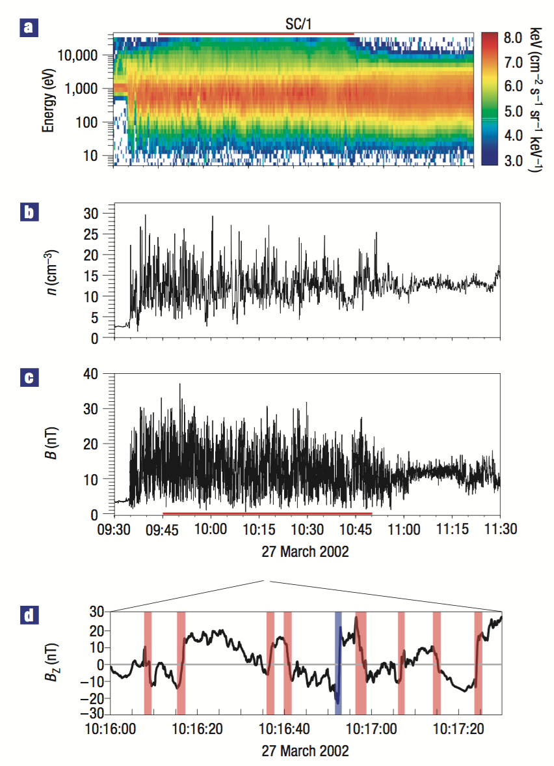
Ion diffusion region, turbulent reconnection (Retinò et al, 2007 Nature Phys.)

Slide 8
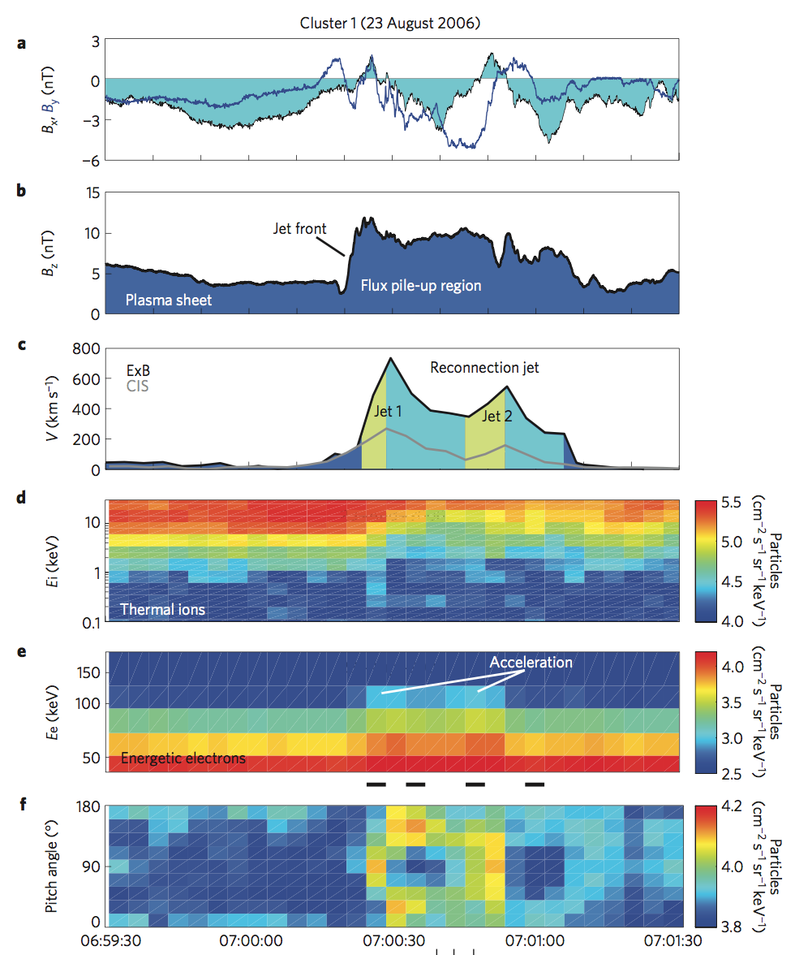
Reconnection jets
(Fu et al., 2013 Nature Phys.)

Slide 9
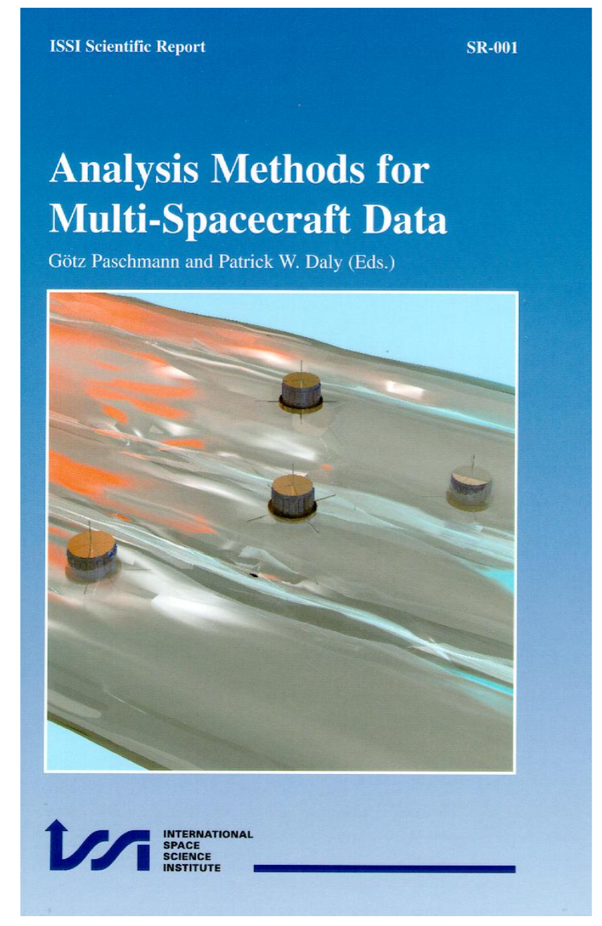
1st edition 2000 www
Revisited www, links to many
Publications using different methods

Slide 10
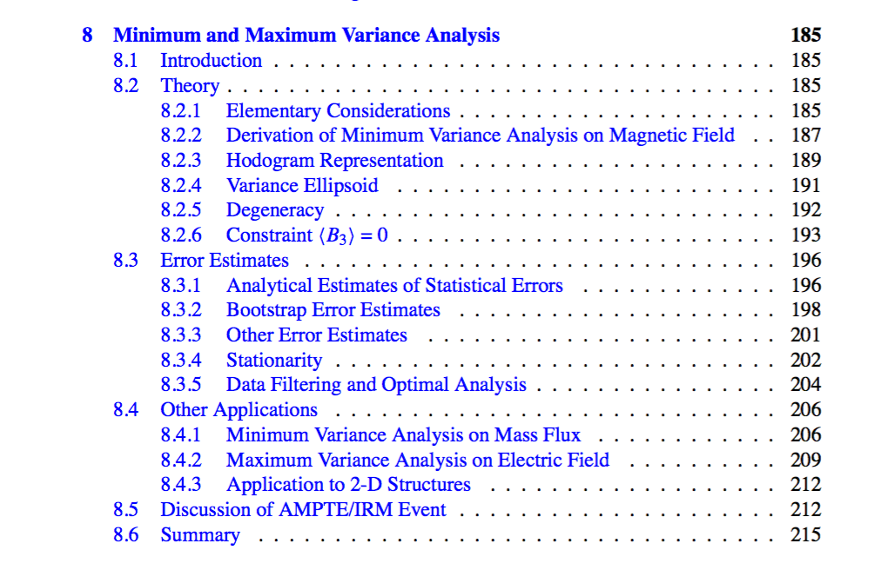
Minimum/Maximums Variance Analysis

Slide 11
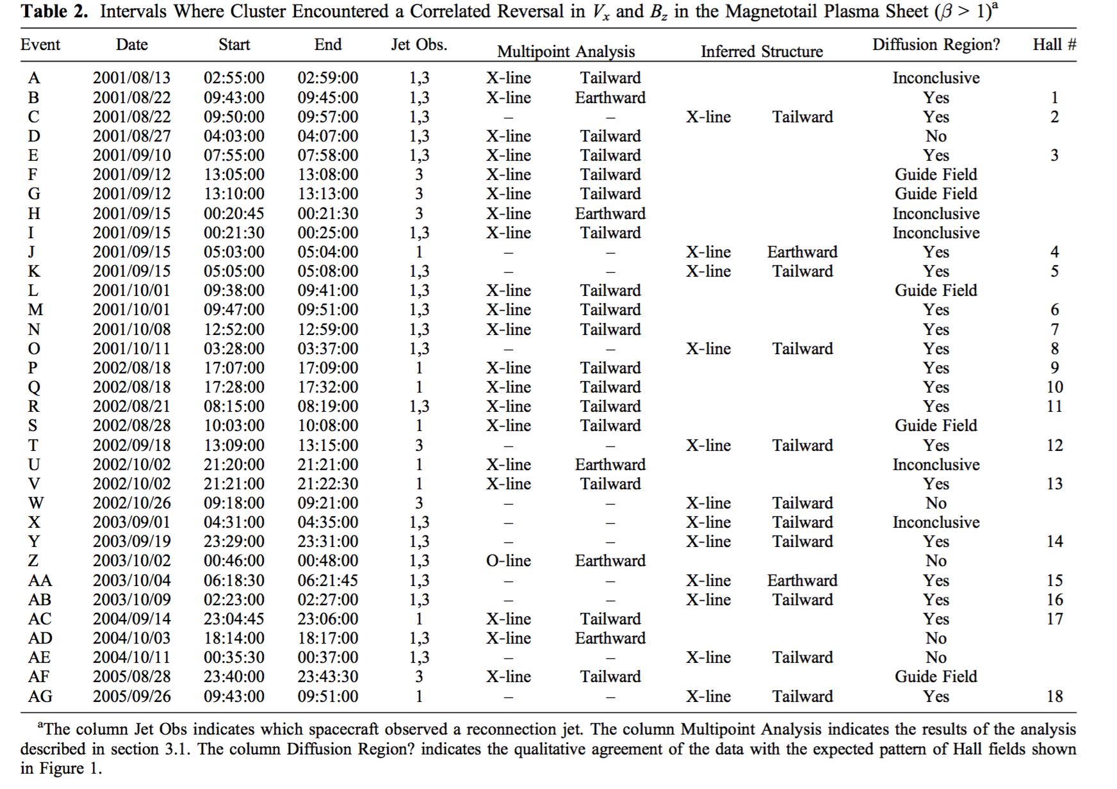
Magnetotail diffusion regions (Eastwood et al., 2010, JGR)

Slide 12
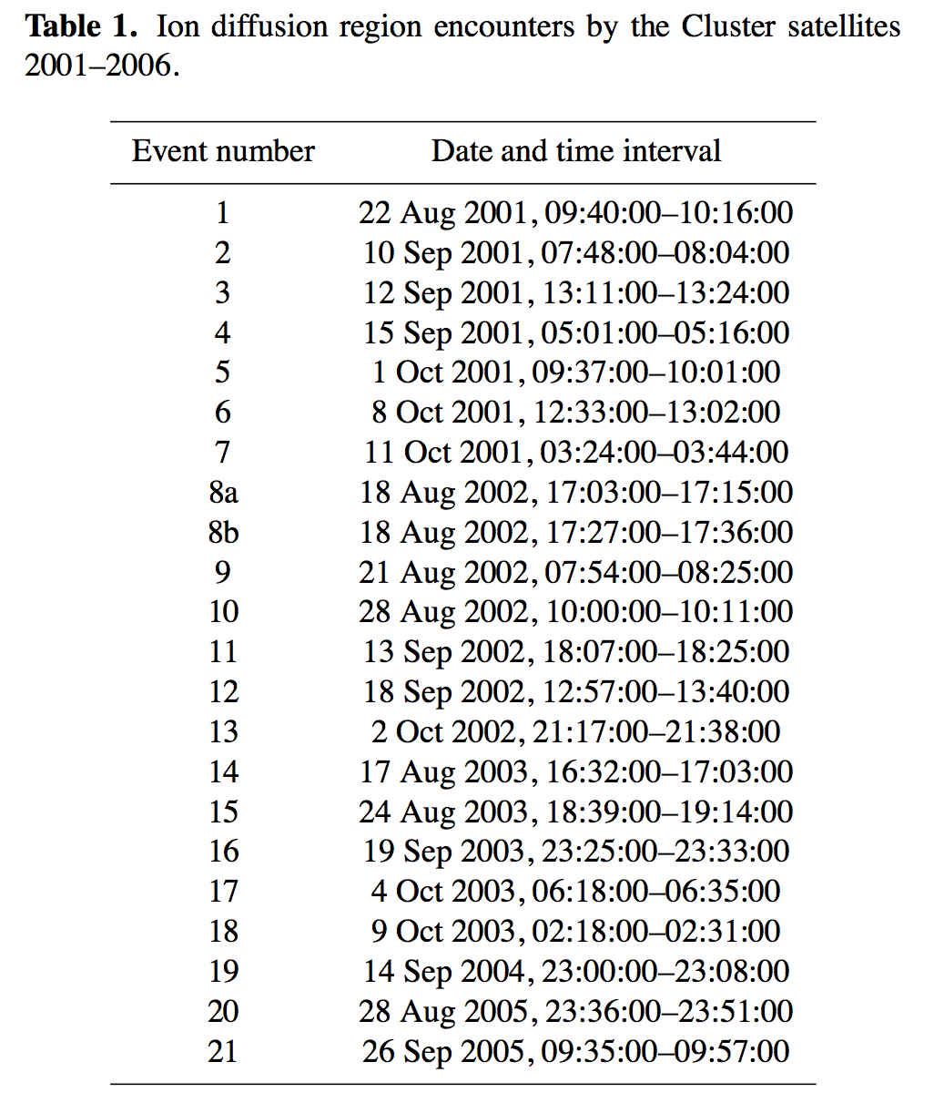
Magnetotail diffusion regions (Borg et al., 2012, AnnGeo)

